Slide 1
Hospital Management System
Sequence Diagram, Activity Diagram, StateChart Presentation Presented by : Group 5
Student ID:1005011
1005016
1005019
1005021
1005024

Slide 2
Outline of the presentation
Subsystems
Sequence Diagram
Activity Diagram
Statechart Diagram

Slide 3
Subsystems
Registration
Patient Management
Employee Management
Billing
Scheduling

Slide 4
1. Registration System
Use-Case Glossary:
Use-case ID>Name | Description | Participant Actors and roles
1.1>Register Patient | PT completes the registration process by giving necessary information to RCP | PT,RCP
1.2>Prepare and View Current Patient List | RCP,AD can see the current patient list | RCP,AD

Slide 5
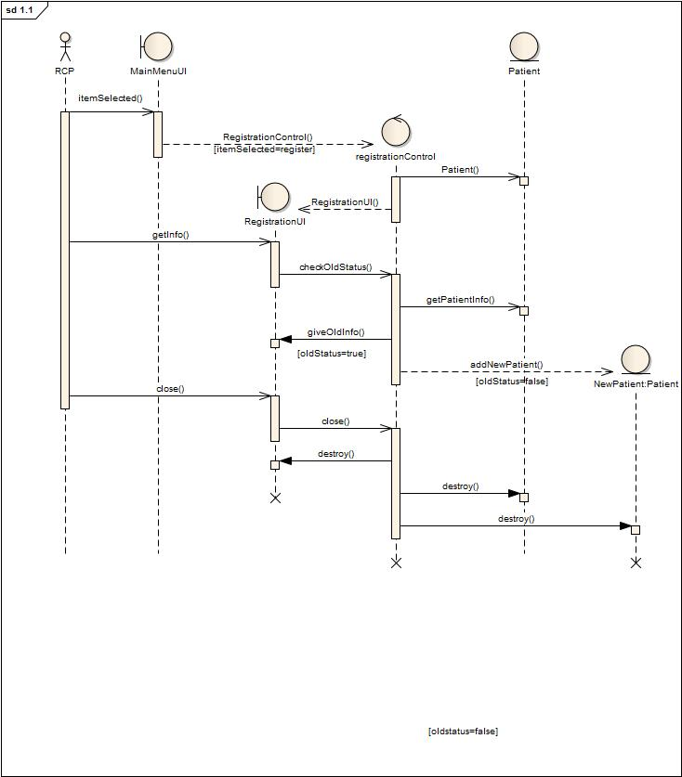
Sequence Diagram 1.1: Register Patient

Slide 6
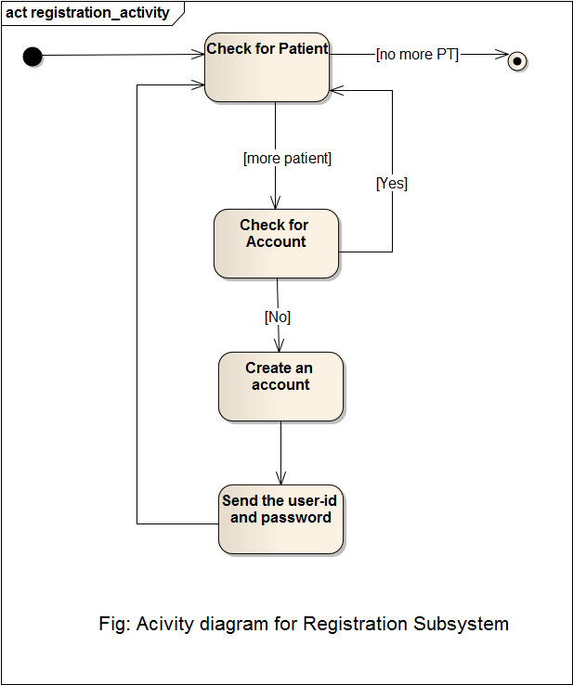
Activity Diagram 1.1:RegisterPatient

Slide 7
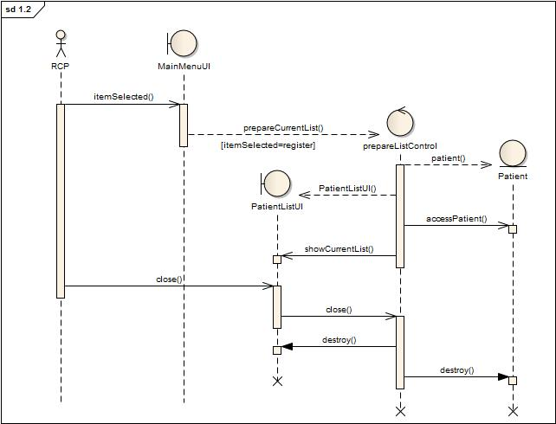
Sequence Diagram 1.2: Prepare and View Current Patient List

Slide 8
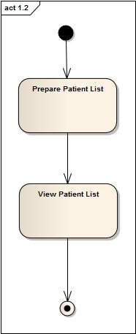
Activity Diagram 1.2: Prepare Current Patient List
Fig: Activity Diagram

Slide 9
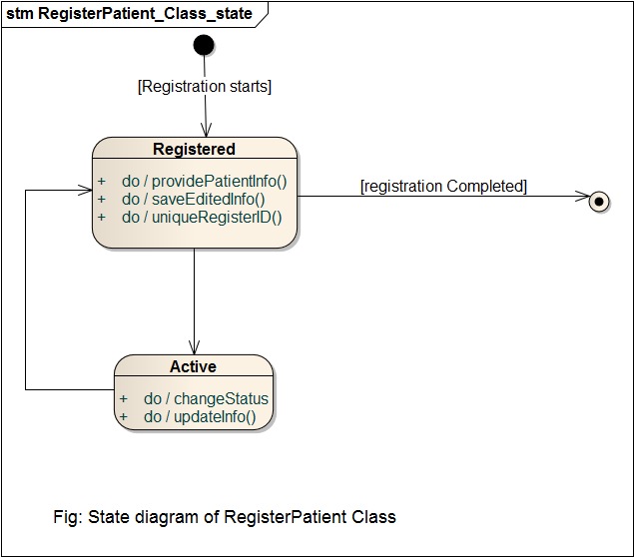
State Chart of Register Patient Class

Slide 10
2.Patient Management
Use-Case Glossary:
Use-case ID>Name | Description | Participant Actors and roles
2.1>Appointment Assign | PT goes to RCP and requests for an appointment, RCP checks the duty schedule of the DOC and makes an appointment | DOC,RCP,PT
2.2>Prepare Prescription | DOC will prepare electronic prescription | DOC
2.3>Update Patient Database | DEM will update the patient database by updating prescription and diagnostic information | DEM
2.4>Cabin/Bed Assign | PT requests for cabin/bed to RCP,RCP contacts with the AD and assigns a bed/cabin | PT,RCP,AD
2.5>Discharge | DOC, CLK permits the PT to be discharged | PT,DOC,CLK

Slide 11
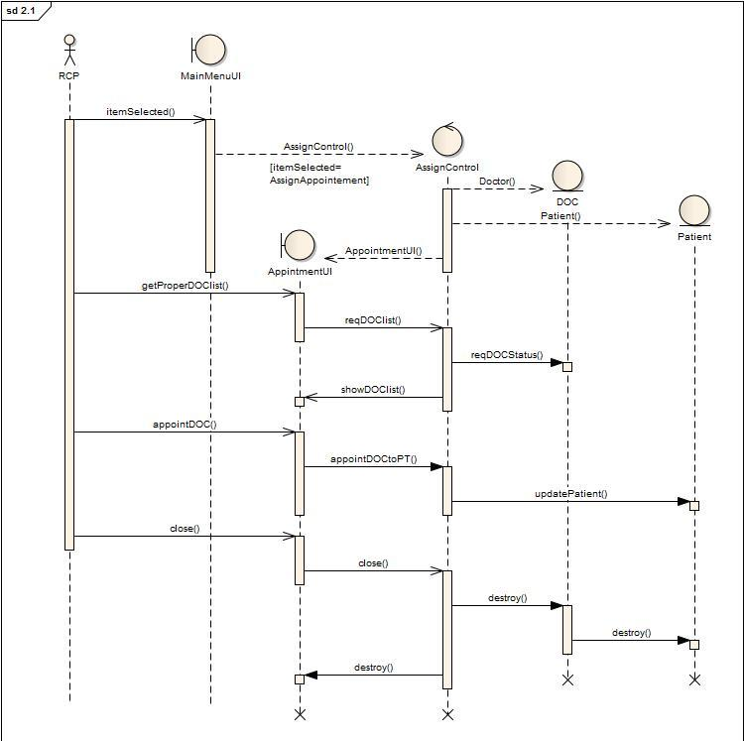
Sequence Diagram 2.1: Appointment Assign

Slide 12
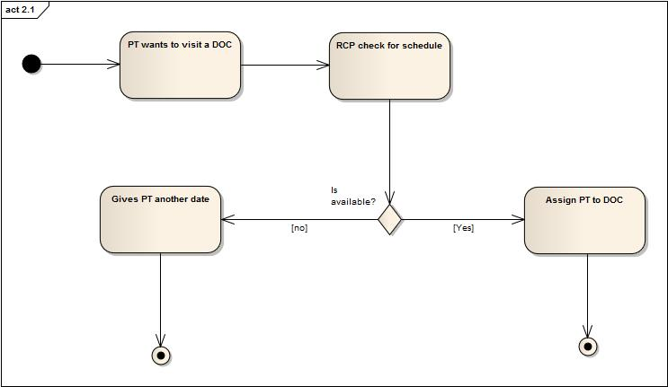
Activity Diagram 2.1: Appointment Assign

Slide 13
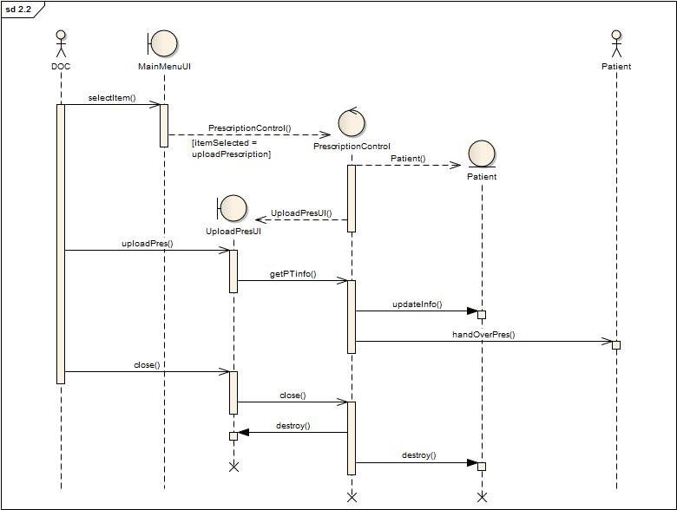
Sequence Diagram 2.2: Prepare Prescription

Slide 14
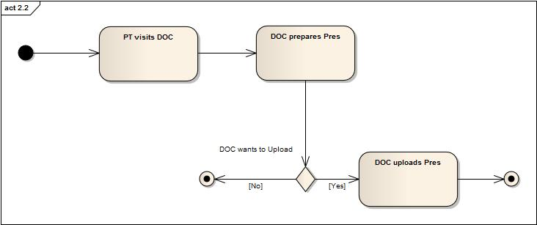
Activity Diagram 2.2: Prepare Prescription
Fig: Activity Diagram

Slide 15
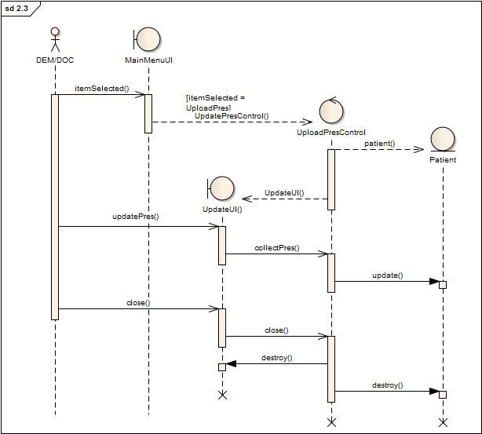
Sequence Diagram 2.3: Update Patient Database

Slide 16
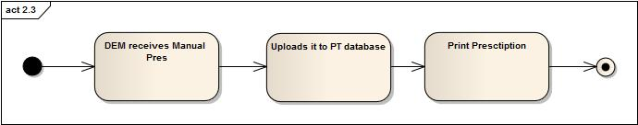
Activity Diagram 2.3: Update Patient Database
Fig: Activity Diagram

Slide 17
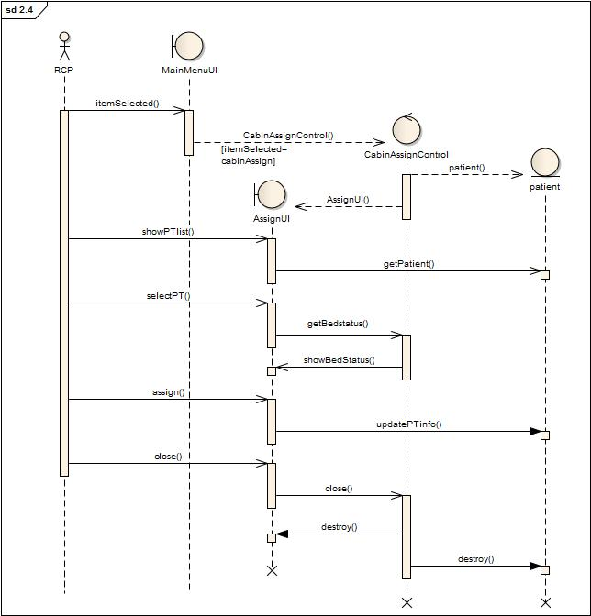
Sequence Diagram 2.4: Cabin/Bed Assign

Slide 18
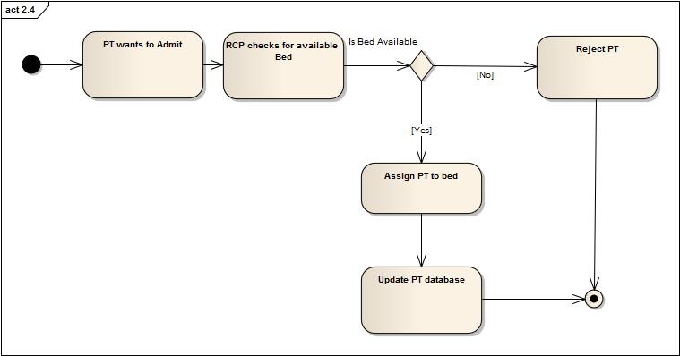
Acitivity Diagram 2.4: Cabin/Bed Assign
Fig: Activity Diagram

Slide 19
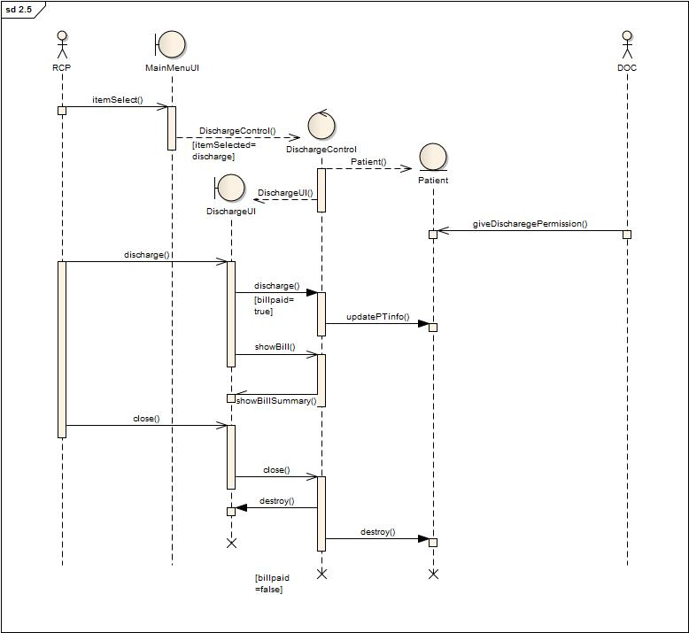
Sequence Diagram 2.5:Discharge

Slide 20
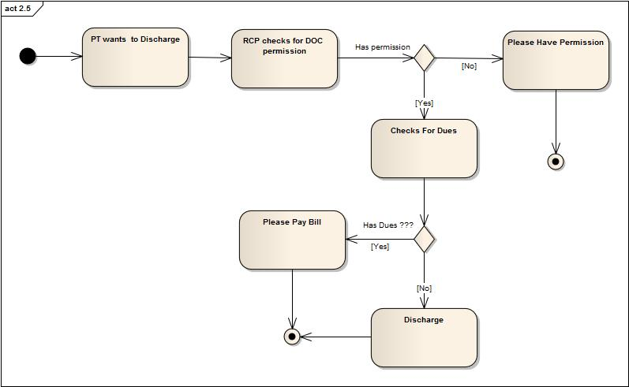
Activity Diagram 2.5:Discharge
Fig: Activity Diagram

Slide 21
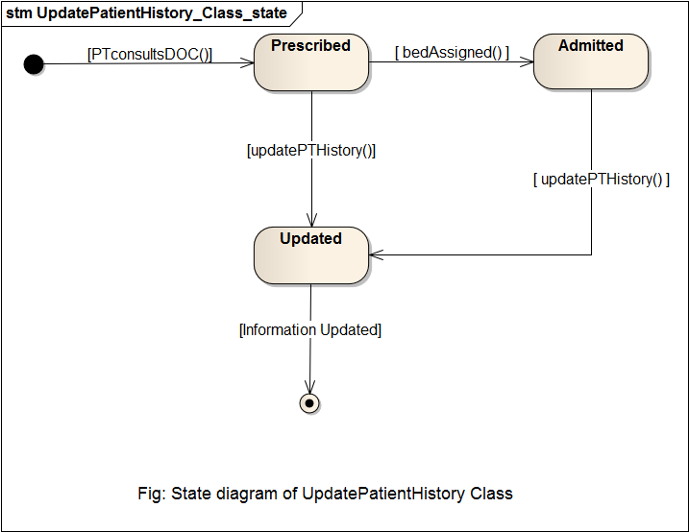
State Chart of Patient management Subsystem

Slide 22
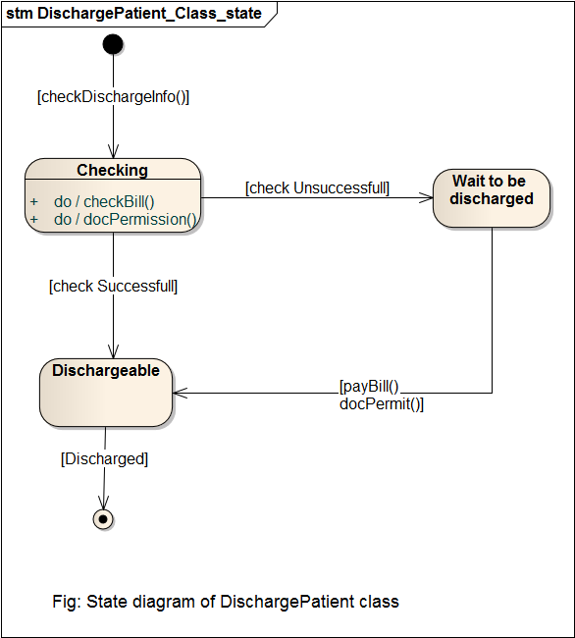
State chart of Patient management Subsystem

Slide 23
3. Employee Management
Use-Case Glossary:
Use-case ID>Name | Description | Participant Actors and roles
3.1> Employee Profile Creation | AD creates new employee profile for each employee in the hospital | AD,EMP
3.2>Receive and Distribute Duty Schedule | HRO gets the duty schedule from 6.2 and gives it to the EMP | HRO
3.3>View Employee List | AD can view the employee list | AD
3.4>Update Employee Profile | AD can update employee profile, AD can also fire an employee, AD changes the pay scale salary | AD,EMP
3.5> Leave Management | EMP applies for leave , AD grants/denies the request and send it back to Scheduling Subsystem | AD,EMP

Slide 24
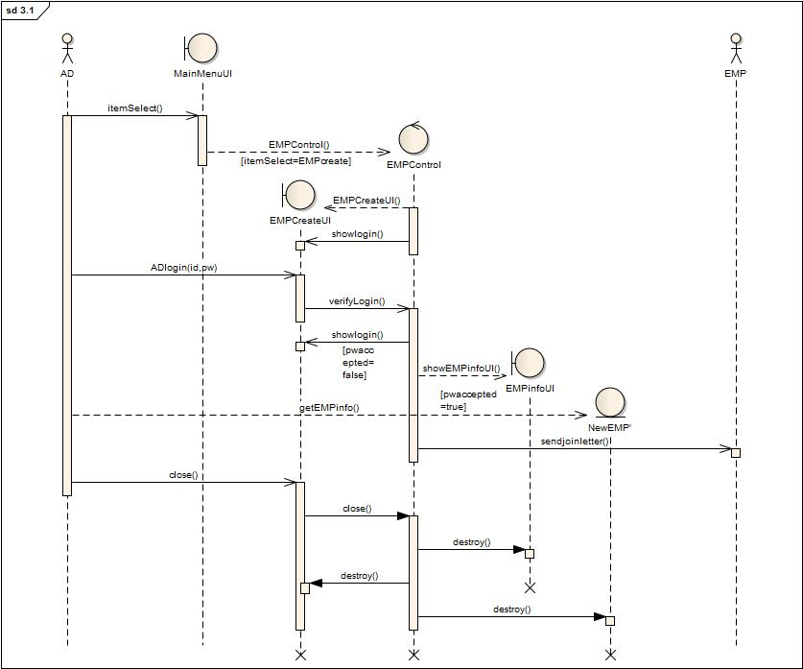
Sequence Diagram 3.1 : Employee Profile Creation

Slide 25
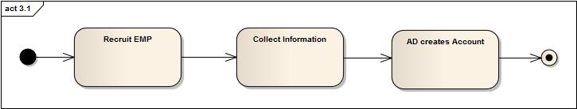
Activity Diagram 3.1 : Employee Profile Creation
Fig: Activity Diagram

Slide 26
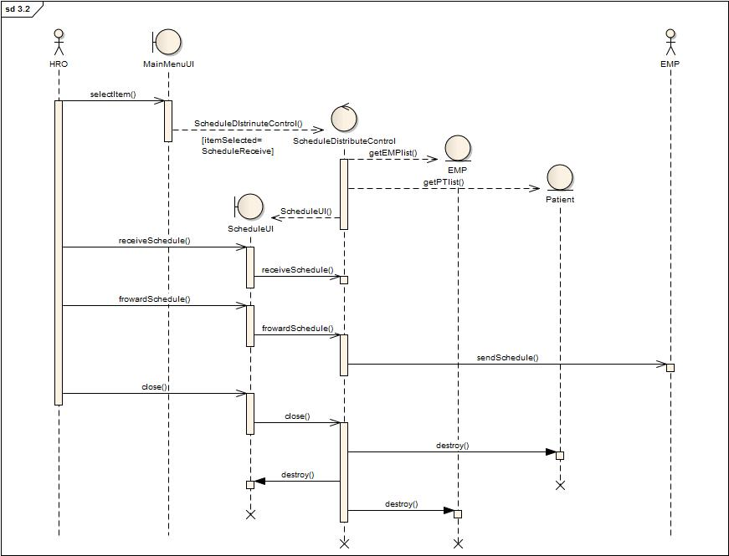
Sequence Diagram 3.2: Receive and Distribute Duty Schedule
Fig: Collaboration Diagram

Slide 27
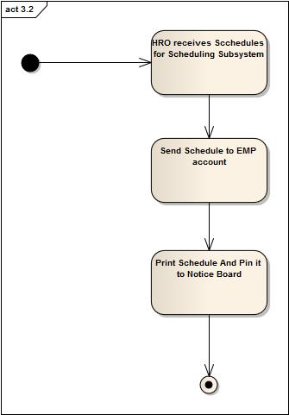
Activity Diagram 3.2: Receive and Distribute Duty Schedule
Fig: Activity Diagram

Slide 28
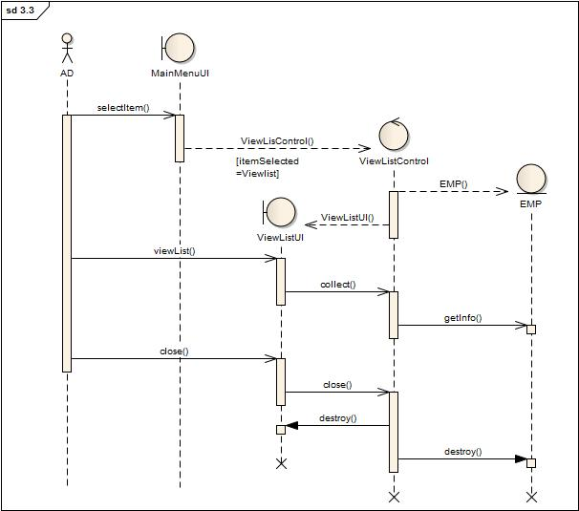
Sequence Diagram 3.3: View Employee List
Fig: Collaboration Diagram

Slide 29
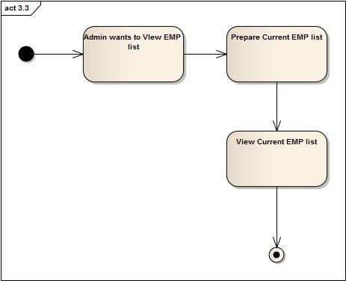
Activity Diagram 3.3: View Employee List
Fig: Activity Diagram

Slide 30
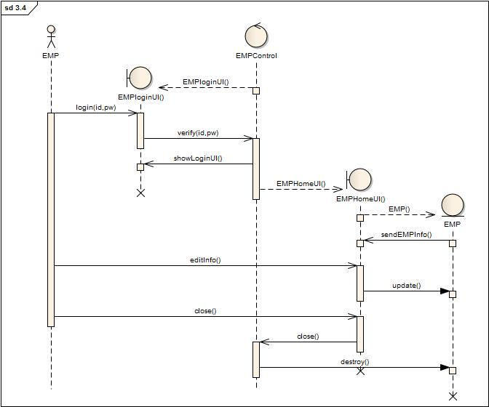
Sequence Diagram 3.4: Update Employee Profile
Fig: Collaboration Diagram

Slide 31
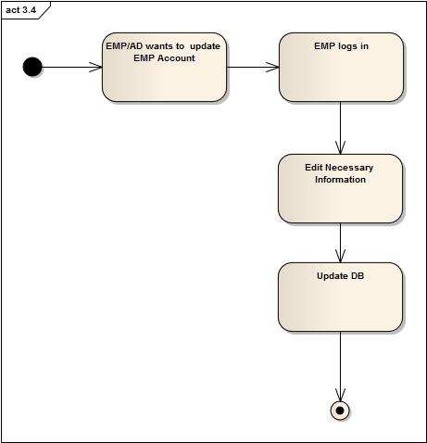
Activity Diagram 3.4: Update Employee Profile
Fig: Activity Diagram

Slide 32
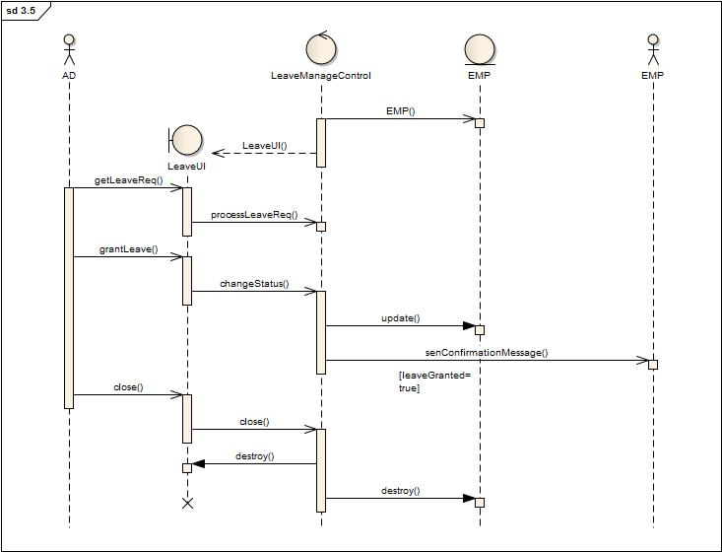
Sequence Diagram 3.5: Leave Management
Fig: Collaboration Diagram

Slide 33
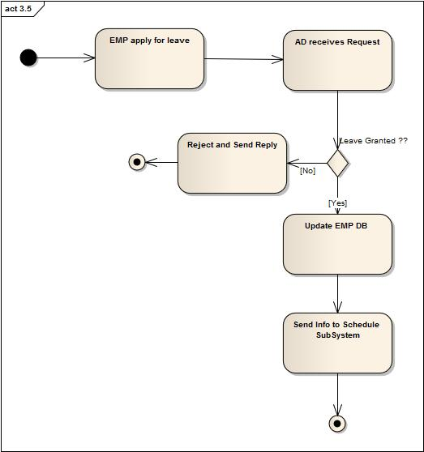
Activity Diagram 3.5: Leave Management
Fig: Activity Diagram

Slide 34
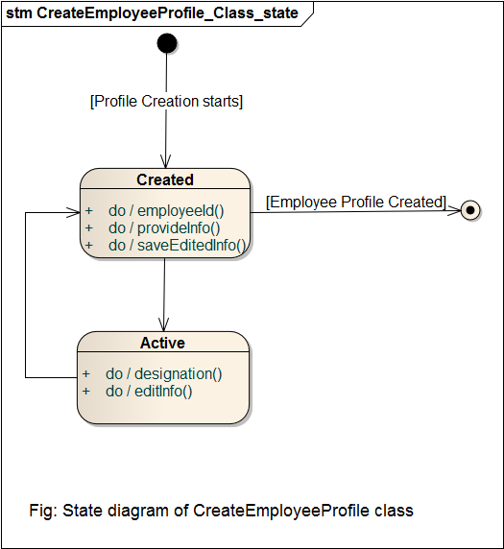
State Diagram of CreateEmployeeProfile Class

Slide 35
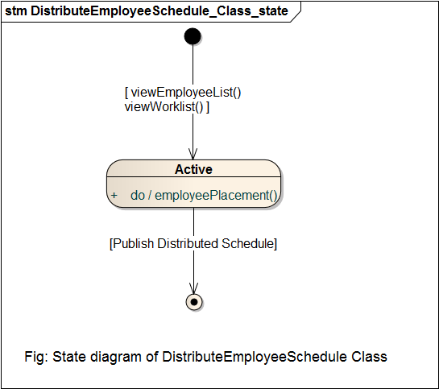
State Diagram of DistributeEmployeeSchedule Class

Slide 36
4. Billing System
Use-Case Glossary:
Use-case ID>Name | Description | Participant Actors and roles
5.1>Collect Bill Information | CLK collects all billing information from PT account | CLK
5.2>Receive bill | PT gives total bill to CLK | PT,CLK

Slide 37
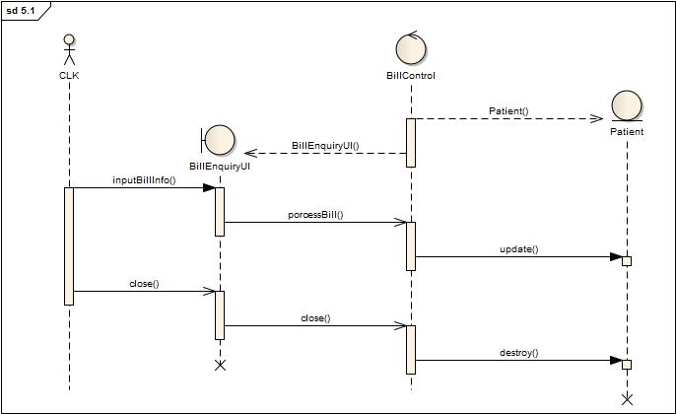
Sequence Diagram 4.1:Collect Bill Information
Fig: Collaboration Diagram

Slide 38
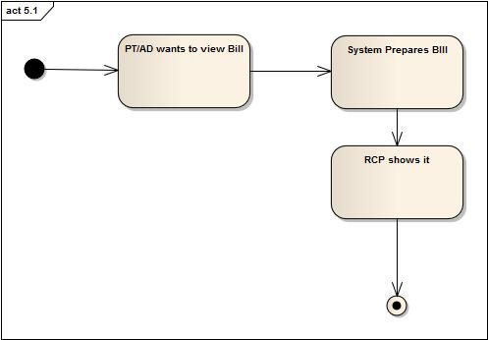
Activity Diagram 4.1:Collect Bill Information

Slide 39
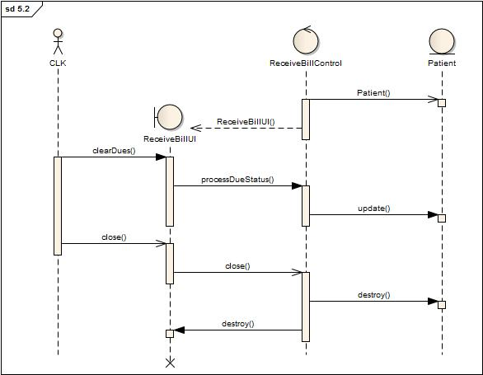
Sequence Diagram 4.2: Receive Bill
Fig: Collaboration Diagram

Slide 40
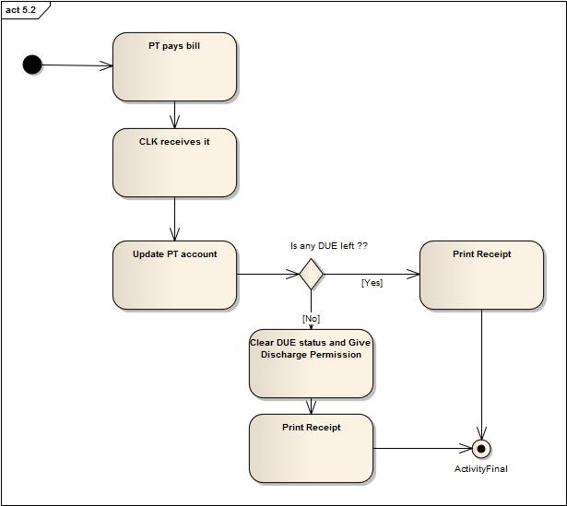
Activity Diagram 4.2: Receive Bill

Slide 41
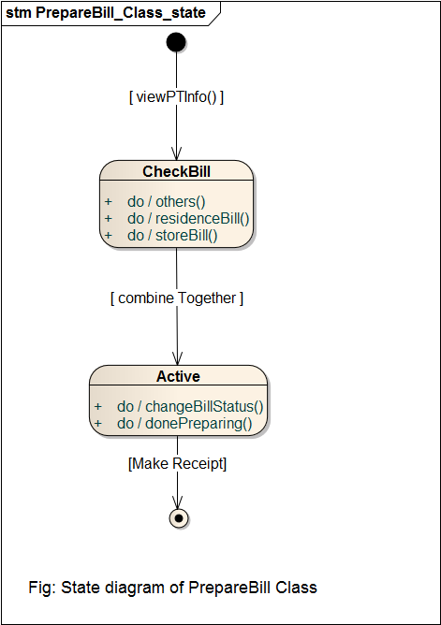
State Diagram of PrepareBill Class

Slide 42
5. Scheduling System
Use-Case Glossary:
Use-case ID>Name | Description | Participant Actors and roles
5.1>Get Active Employee List | Scheduling Subsystem gets the active employee list | AD
5.2>Duty Schedule | Scheduling Subsystem prepares duty schedules of all employees | AD

Slide 43
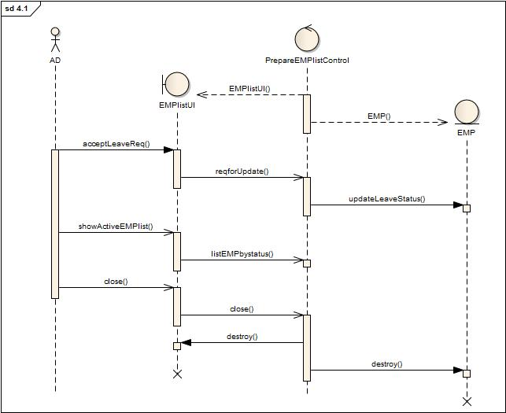
Sequence Diagram 5.1: Active Employee List
Fig: Collaboration Diagram

Slide 44
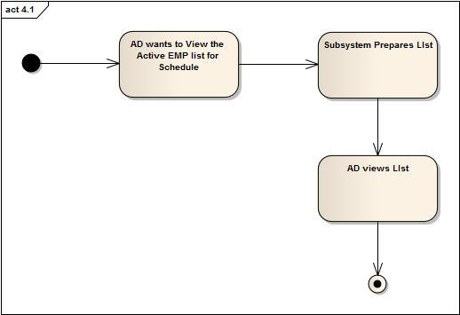
Activity Diagram 5.1: Active Employee List
Fig: Activity Diagram

Slide 45
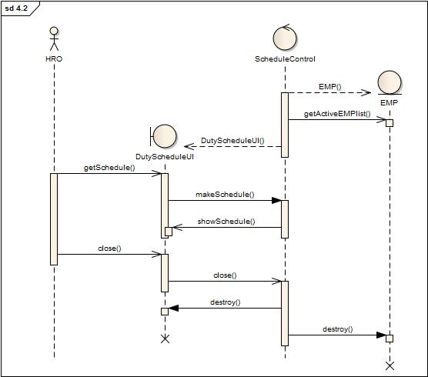
Sequence Diagram 5.2: Duty Schedule
Fig: Collaboration Diagram

Slide 46
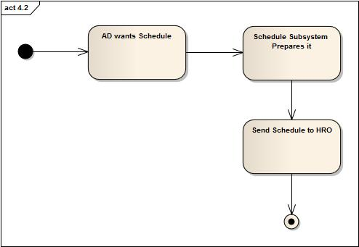
Activity Diagram 5.2: Duty Schedule

Slide 47

QUESTIONS???

Slide 48
Thank You

